Slide 1
ONLINE AUCTION &
BIDDING SYSTEM
$
PRESENTED BY
Name - Sriram Reddy Roll No - 2620030135
Name - Sri Vyshnavi Roll No - 2620030114

Slide 2
Abstract
A console-based auction where the highest valid bid wins
Java-based online auction platform where sellers list items and buyers place live bids
01
Automates bid validation, highest-bid tracking, auction closing and winner selection
02
Built with the six course modules: foundations, control flow, methods, OOP, file I/O and collections
03
Replaces manual, error-prone auctions with a fast, fair and transparent system
04

Slide 3
Understanding Problem Statement
Why an automated bidding system is needed
Traditional auctions need physical presence, are slow and hard to audit
01
Manual bid tracking causes errors, disputes and unfair winner selection
02
Need: validate bids, enforce the increment rule, handle invalid input and keep records
03
Goal: a reliable console application for users, items, bids and results
04

Slide 4
Module 1: Computational Thinking & Java Foundations
Algorithm design, data types, Scanner input and the main() skeleton
Decompose: users, items, bids, winner
Algorithm: register → list → bid → close → winner
Data types: int, double, boolean, String
Scanner for input, printf for output
Why & What
01
MODULE 1 OF 6
WHAT is used
• Data types: int (item id), double (prices), boolean (running / open flag), String (names)
• Scanner for keyboard input, System.out.printf for formatted output
• Algorithm: register → list item → place bids → close → winner
• main() entry point with a loop that keeps the program running
WHY it is used
• Decomposing the problem first keeps the design simple: users, items, bids, winner
• Correct data types avoid rounding and logic errors (money needs double, flags need boolean)
• Scanner/printf give a clear, aligned console interface without any GUI

Slide 5
Module 2: Control Flow
switch, if / else and loops drive the menu and validation
switch drives the main menu
if / else validates every request
while loop keeps the app running
for loop prints every item
Why & What
02
MODULE 2 OF 6
WHAT is used
• switch statement to route each menu choice to a feature
• if / else to validate roles, item ids and empty lists
• while loop to keep showing the menu until Exit
• for loop to print every item in the table
WHY it is used
• switch is cleaner and faster to read than many if-else chains for a fixed menu
• if / else stops invalid requests before they change auction data
• Loops let users do many actions in one run and avoid repeating code

Slide 6
Module 3: Methods, Recursion & Arrays
Methods, recursion and arrays split the work into reusable pieces
Methods split the work into small pieces
Recursion: readPrice() retries bad input
Overloading: findItem(int) and findItem(String)
Array: CATEGORIES for item types
Why & What
03
MODULE 3 OF 6
WHAT is used
• Methods: register(), listItem(), placeBid(), closeAuction() each do one job
• Recursion: readPrice() calls itself until a valid positive number is entered
• Overloading: findItem(int id) and findItem(String name)
• Array: CATEGORIES = {Art, Electronics, Books, Other}
WHY it is used
• Small methods are reusable, easier to test and easier to debug
• Recursion gives simple retry-on-bad-input without a messy loop
• Overloading lets one concept (find an item) work with different inputs
• A fixed array suits a short list of categories that never changes

Slide 7
Module 4: OOP & Exception Handling
Classes, inheritance, encapsulation and custom exceptions
Classes: User, Seller, Bidder, Bid, Item
Inheritance with abstract role()
Encapsulation: private name + getName()
Custom checked exceptions for bid rules
Why & What
04
MODULE 4 OF 6
WHAT is used
• Classes: User (abstract), Seller, Bidder, Bid, Item
• Inheritance and abstract role() with polymorphism
• Encapsulation: private name with getName()
• Custom checked exceptions: AuctionException, InvalidBidException, AuctionClosedException
WHY it is used
• Classes model real-world objects, so the code mirrors the auction
• Inheritance shares common user code; polymorphism lets each role behave differently
• Encapsulation protects data from accidental change
• Custom exceptions enforce bid rules (minimum increment, closed auction) and give clear error messages

Slide 8
Module 5: Strings, Algorithms & File I/O
Regex validation, insertion sort and saving data to a file
Strings: regex validates usernames
Insertion sort ranks items by bid
File I/O: save and load auction.txt
try-with-resources closes files safely
Why & What
05
MODULE 5 OF 6
WHAT is used
• String.matches() with regex [A-Za-z][A-Za-z0-9_]{2,15} to validate usernames
• Insertion sort to rank items by highest bid
• File I/O: PrintWriter / FileWriter to save, BufferedReader / FileReader to load auction.txt
• try-with-resources to close files automatically
WHY it is used
• Regex rejects bad or unsafe names in a single line
• Sorting shows the hottest items first; insertion sort is simple for small lists
• File I/O keeps data after the program exits, so the auction is not lost
• try-with-resources prevents resource leaks even when an error occurs

Slide 9
Module 6: Collections, Functional Programming & Streams
Maps, streams, lambdas and Optional pick the winner
LinkedHashMap and HashMap hold items and users
Streams find the winner and the counts
Lambdas + Comparator for sorting
Optional handles items with no bids
Why & What
06
MODULE 6 OF 6
WHAT is used
• LinkedHashMap for items (keeps listing order) and HashMap for users (fast lookup by name)
• Streams + Comparator.max() to find the winning bid
• Collectors.groupingBy, lambdas and merge() for statistics
• Optional to handle items that have no bids
WHY it is used
• Maps give fast lookup by id or name instead of scanning lists
• Streams and lambdas make the winner and statistics short and readable
• Optional avoids NullPointerException when nobody bid - shows "unsold" safely

Slide 10
Complete Program Code
The whole auction system in one small, runnable Java file
AuctionSystem.java
import java.util.*;
public class AuctionSystem {
static Scanner sc = new Scanner(System.in);
static ArrayList<Item> items = new ArrayList<>();
static class Item {
String name, bidder = "nobody";
double price;
boolean open = true;
Item(String n, double p) { name = n; price = p; }
}
static void addItem() {
System.out.print("Item name: ");
String name = sc.next();
System.out.print("Starting price: ");
double price = sc.nextDouble();
items.add(new Item(name, price));
System.out.println("Added. Item id = " + items.size());
}
static Item getItem() {
System.out.print("Item id: ");
int id = sc.nextInt();
if (id < 1 || id > items.size()) {
System.out.println("No such item");
return null;
}
return items.get(id - 1);
}
static void placeBid() {
Item item = getItem();
if (item == null) return;
if (!item.open) { System.out.println("Auction is closed"); return; }
System.out.print("Your name: ");
String who = sc.next();
System.out.print("Your bid: ");
double bid = sc.nextDouble();
if (bid > item.price) {
item.price = bid;
item.bidder = who;
System.out.println("Bid accepted!");
} else
System.out.println("Bid must be higher than " + item.price);
}
static void showItems() {
for (int i = 0; i < items.size(); i++) {
Item it = items.get(i);
System.out.println((i + 1) + ". " + it.name + " price: "
+ it.price + " " + (it.open ? "OPEN" : "CLOSED"));
}
}
static void closeAuction() {
Item item = getItem();
if (item == null) return;
item.open = false;
if (item.bidder.equals("nobody"))
System.out.println("No bids - item unsold");
else
System.out.println("Winner: " + item.bidder + " with " + item.price);
}
public static void main(String[] args) {
while (true) {
System.out.print("\n1.Add 2.Bid 3.Show 4.Close 0.Exit: ");
int choice = sc.nextInt();
switch (choice) {
case 1: addItem(); break;
case 2: placeBid(); break;
case 3: showItems(); break;
case 4: closeAuction(); break;
case 0: return;
default: System.out.println("Invalid choice");
}
}
}
}

Slide 11
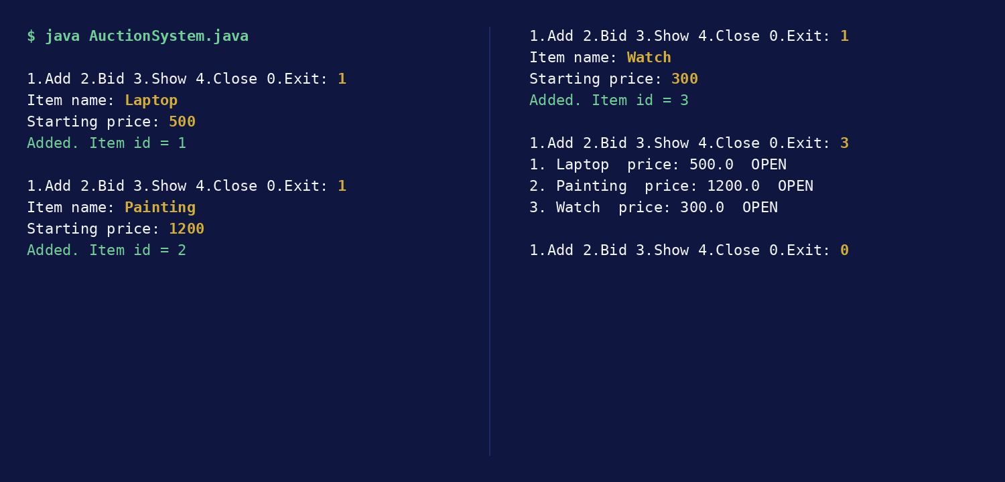
Output 1: Adding & Listing Items
Three items are added, then listed with their price and OPEN status
Terminal - java AuctionSystem.java

Slide 12
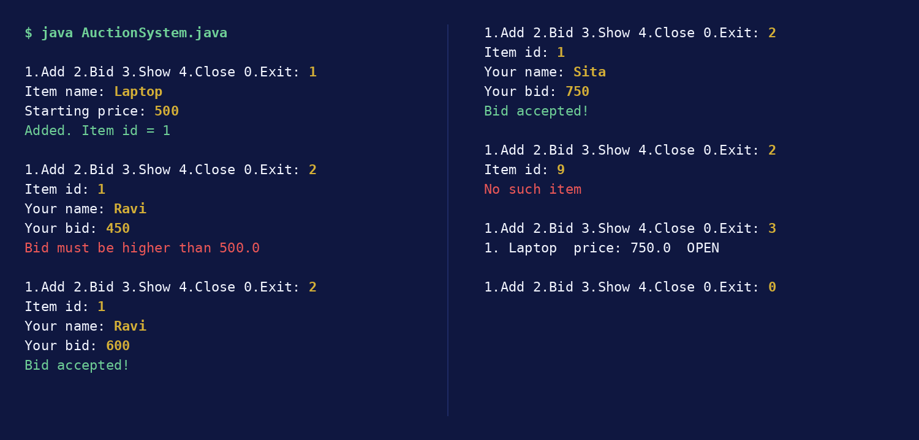
Output 2: Placing Bids
A low bid is rejected, higher bids are accepted and an unknown item id is handled
Terminal - java AuctionSystem.java

Slide 13
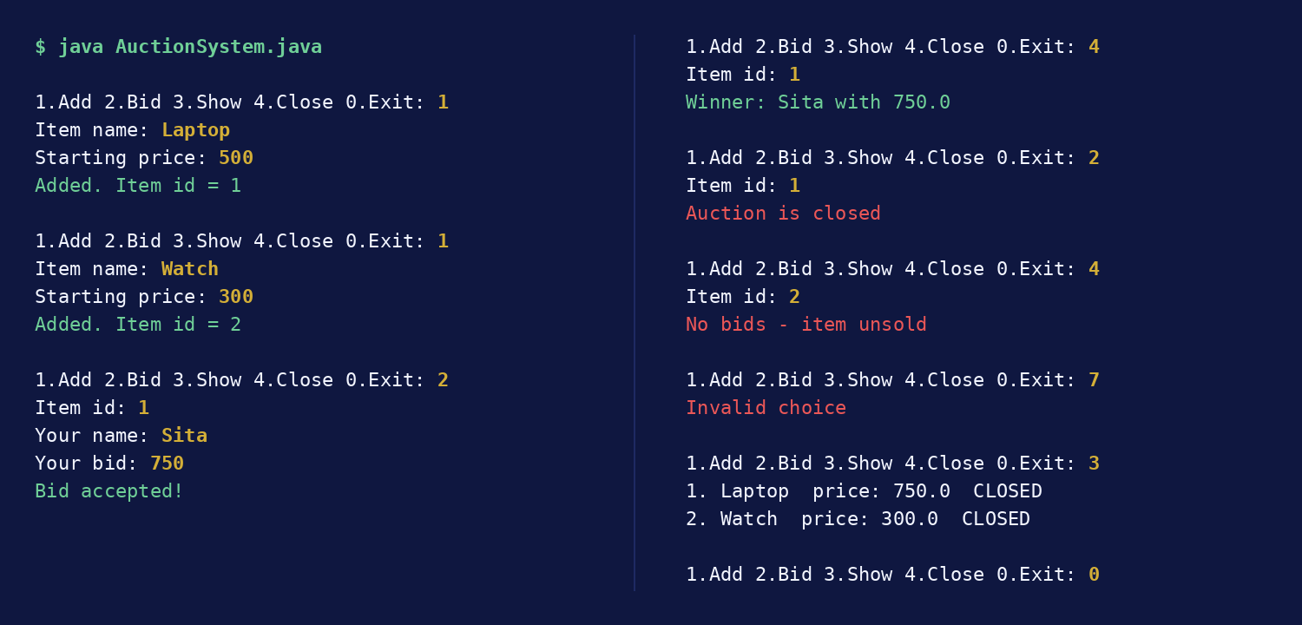
Output 3: Closing Auctions
Winner announced, closed item blocked, unsold item and invalid choice handled
Terminal - java AuctionSystem.java

Slide 14
Conclusion
What was achieved and where it can go next
Delivered a working online auction and bidding system in Java
01
Applied all six modules, from fundamentals to collections and streams
02
Future scope: GUI or web front end, database storage, payments, real-time notifications
03

Slide 15
GitHub Repository
Source code and project files
Paste your GitHub repository link here (https://github.com/your-username/your-repo)
GH

